Slide 1

Telemarketing Banking Strategy : Predicting Customer Response to Term Deposit Campaigns
Team Member Names:
Vladomir Jungkman
Gang Wei
Ann Nyawira
Tasnim Shairy

Slide 2
Introduction
Telemarketing is a direct marketing technique used in the banking industry to contact potential customers and promote products or services.
Term deposits are fixed-term investments where customers deposit money into a bank account for a specified period, earning higher interest rates than regular savings accounts.
Term deposits provide a stable source of funding for banks, enabling banks to lend money to other customers at a higher rate and generate profits.

Slide 3

Project Importance
Identifying the factors that influence customers' likelihood to make term deposits is crucial for banks to optimize their telemarketing strategies.
By understanding these factors, banks can allocate resources effectively, targeting the right customers and improving the efficiency of their campaigns.
This project analyzes customer data from a Portuguese bank's telemarketing campaign to predict which customers are more likely to subscribe to term deposits.

Slide 4
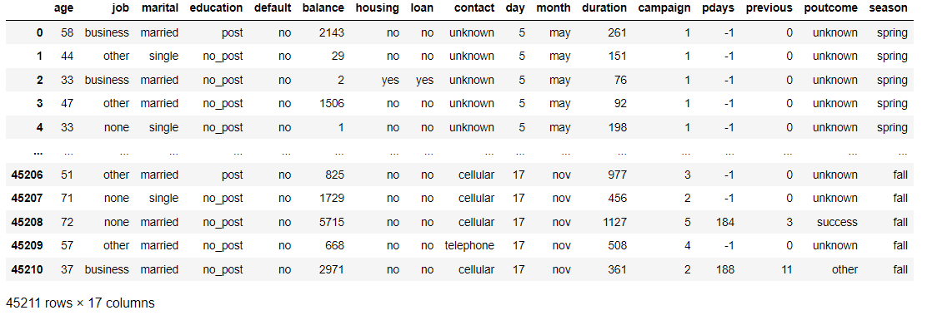
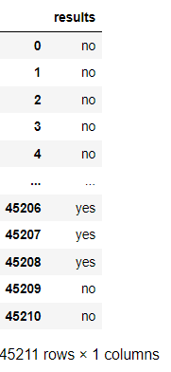
Dataset Overview

Slide 5

Selected Machine Learning Models
Decision Tree
K-Nearest Neighbors (KNN)
Gradient Boosting
Random Forest
Logistic Regression
Support Vector Machine (SVM)
Naive Bayes

Slide 6
Recall Scores
Model Name | True Positives | Recall Score
Naïve Bayes | 912 | 57.76%
Gradient Boost | 619 | 39.20%
Random Forest | 566 | 35.85%
Decision Tree | 564 | 35.72%
Logistic Regression | 287 | 18.18%
Knn | 232 | 14.69%
SVM | 11 | .70%

Slide 7

Model Comparison and Selection
Among all the models evaluated, the Naive Bayes model demonstrated the best performance, with a recall of 57.76%.
Other factors to look into with data and program
Training Time
Resources
Data Ambiguity

Slide 8

Audience Takeaways
1. Data-driven targeted marketing optimizes campaign effectiveness and ROI
2. Machine learning predicts customer behavior, informs decisions and strategies
3. Key variables (age, previous outcomes, contact duration, employment) influence customer decisions
4. Data-driven decision-making and analytics are crucial for staying competitive

Slide 9

Q&A

